Slide 1
Genomic analysis of Mycobacterium tuberculosis in the big data era
Jody Phelan
DIB, LSHTM

Slide 2
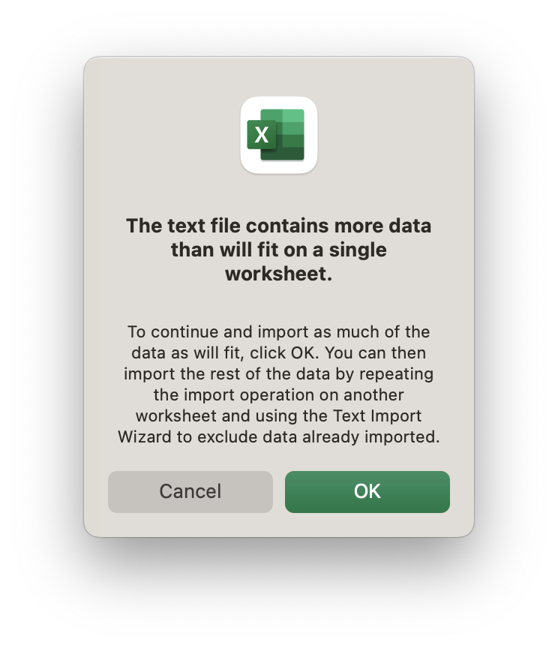
What is big data?
Big data refers to the large, diverse sets of information that grow at ever-increasing rates.
Big data is any file that will make your computer crash
Data is stored in RAM to be accessed rapidly
If dataset is larger than the amount of RAM available it is big

Slide 3
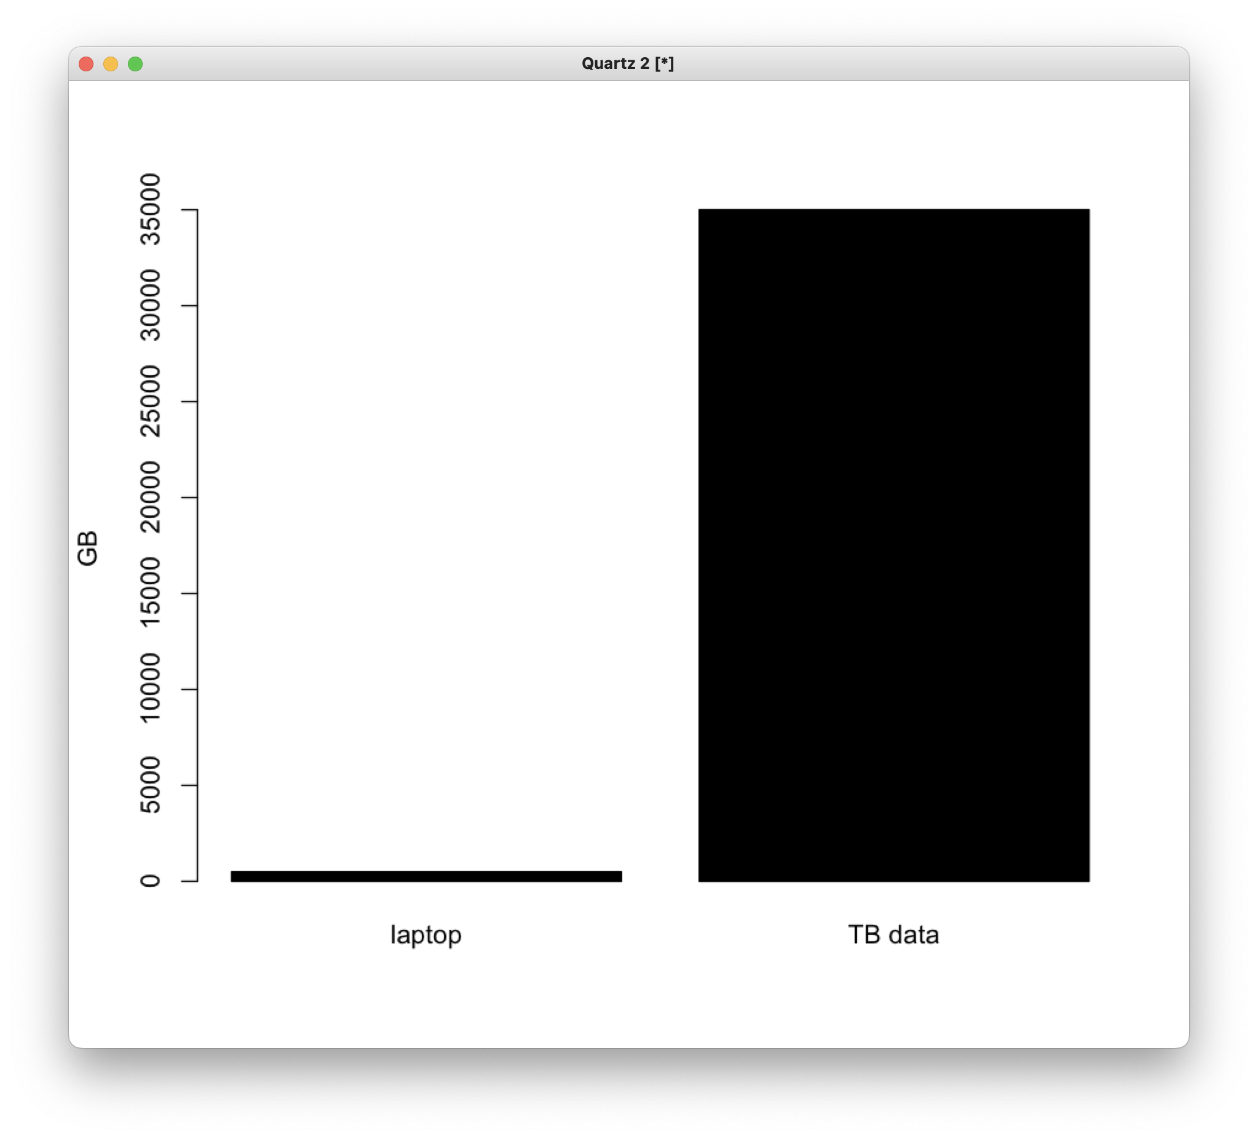
35TB
0.5TB

Slide 4
ACGTAGTGTAAGCTGTTAGAC
TAAGCT
CTGTTA
TCGTGT
ACGTCG
TTGGAC
TTAGAC
TAAGCT
CGTCGT

Slide 5
ACGTAGTGTAAGCTGTTAGAC
ACGTCG
TAAGCT
TTGGAC
TCGTGT
CTGTTA
CGTCGT
TAAGCT
TTAGAC
Isolate 1:
ACGTCGTGTAAGCTGTTAGAC
Isolate 2:
ACGTAGTGTAAGCTGGTAGAC

Slide 6
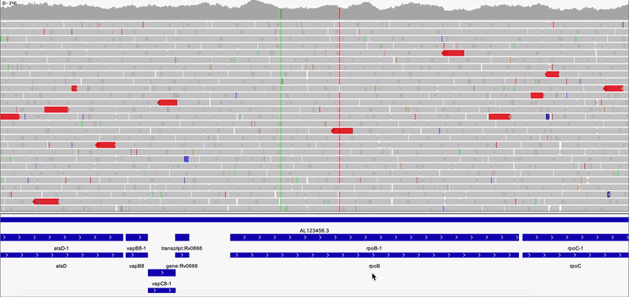
Genomics data processing
Variant calling is the process of finding differences between your data and the reference genome
FastQ
Trimmed
FastQ
trimmomatic
.bam
samtools sort
bwa mem
bcftools mpileup
bcftools call
-m -v
.vcf

Slide 7
Drug Resistance Prediction

Slide 8

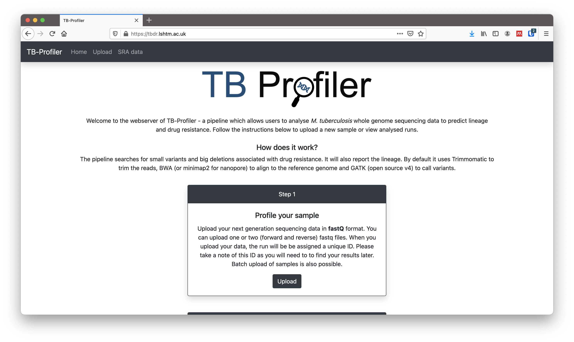
Genomics data processing
rpoB S450L - RIF
katG S315T - INH
RIF R
INH R
EMB S
PZA S
Notes:
Its quite easy to spot variants by looking at the visualization, but if we tried to do this for a single genome we would be here for weeks. Luckily for us, software exists which can automatically do this for us. The process is called variants calling, and tools use statistical approaches to find variants in the data.

Slide 9
TCGTGT
RIF R
INH R
EMB S
PZA S
CGTCGT
CTGTTA
ACGTCG
TAAGCT
TTAGAC
TTGGAC
TAAGCT
5 mins per sample
138K samples
479 days to process

Slide 10




RIF R
INH R
EMB S
PZA S
Pathogen Genomics Server
TCGTGT
CGTCGT
CTGTTA
ACGTCG
TAAGCT
TTAGAC
850 cores
5TB RAM
700TB Disk
TTGGAC
TAAGCT

Slide 11
Genomics data processing
?
rpoB S450L - RIF
katG S315T - INH
RIF R
INH R
EMB S
PZA S

Slide 12
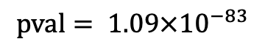
TB Genome wide association studies
 | Resistant | Sensitive
Mutation + | 123 | 1
Mutation - | 50 | 430
$$pval= 1.09×{10}^{−83}$$

Slide 13
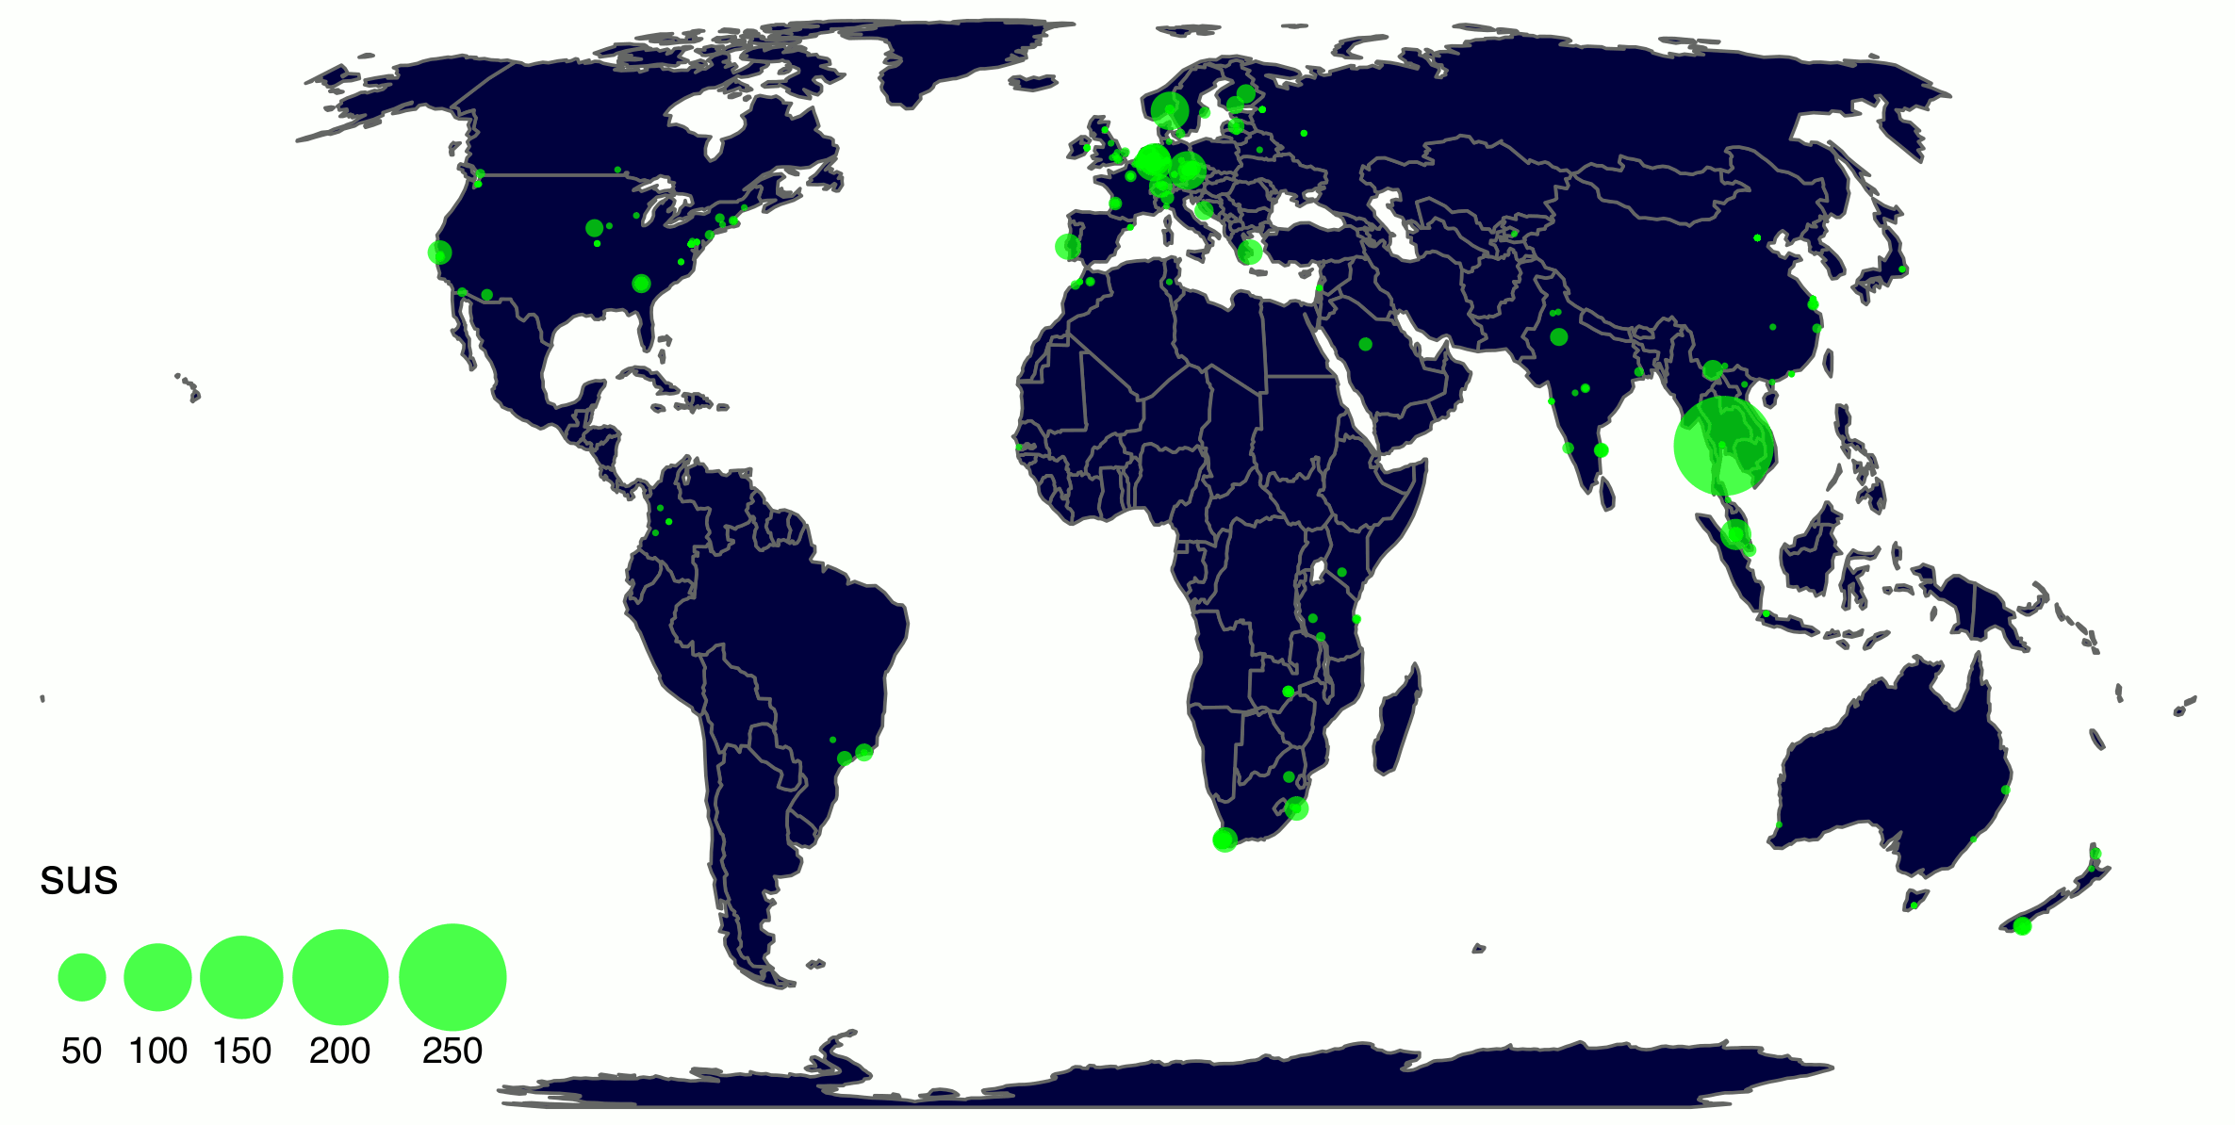
Real-time Mtb characterization by TB-Profiler users

Slide 14
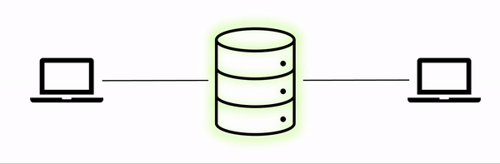

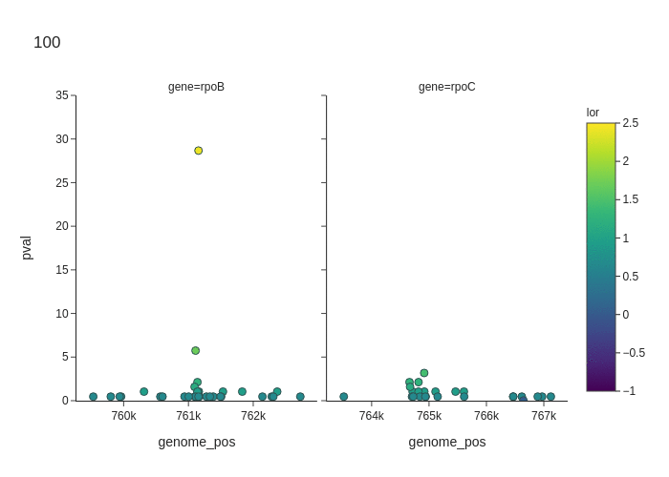


TBDR
TBDB
-log10(pval)

Slide 15
Getting AI resistance-prediction models to run
Many new machine learning (ML) tools for predicting drug resistance from genomic data every year.
Most report “better performance than traditional methods”.
But usually lack simple ways of using / testing the models.
We have to get them running, but
the trained models are often not available.
frequently, the source code is not there either.
or dependencies are not specified.
sometimes they are, but then the training data is missing.
or the github repo lacks the scripts / pipelines for data pre-processing (and Methods sections are vague about the pre-processing pipeline).
or …

Slide 16


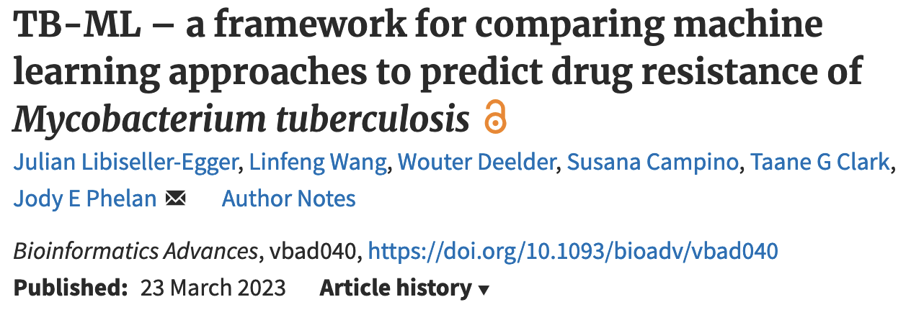
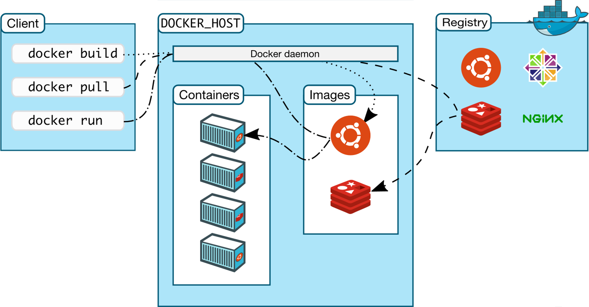
Containerisation – a brief overview
A “Mini VM” for a single application
Cross-platform
No more “dependency hell”
Get the same results – everywhere
Frictionless sharing of software
…
https://docs.docker.com/engine/images/architecture.svg

Slide 17
Tracking Transmission

Slide 18

Transmission analysis based on genetic similarity
Mtb from from transmission chains will have near-identical genomes
A SNP distance threshold can be set to establish transmission pairs
To find links, a given sample must be compared to every other sample
Compute time is now exponential
Isolate 1:
ACGTCGTGTAAGCTGTTAGAC
Isolate 2:
ACGTAGTGTAAGCTGGTAGAC

Slide 19
Developing efficient algorithms
Traditional way is to create a distance matrix (19TB for all samples)
New algorithms work to efficiently store data for individual samples to enable rapid reading from disk
SNP-difference to reference stored and converted into pairwise snp-distance using set operations
This allows quick cycling through all pairs minimizing the load+compute time
After initial processing allows for 8k comparisons per second
 | S1 | S2 | S3
S1
S2 | 0
S3 | 6 | 6

Slide 20
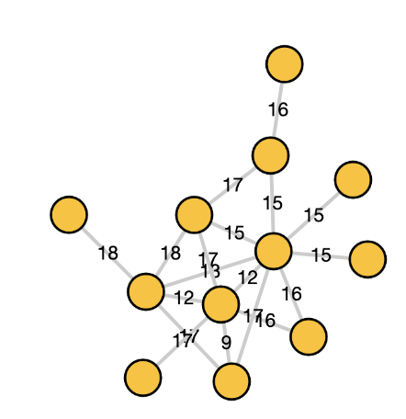
RIF R
INH R
EMB S
PZA S
TCGTGT
CGTCGT
CTGTTA
ACGTCG
TAAGCT
TTAGAC
TTGGAC
TAAGCT

Slide 21
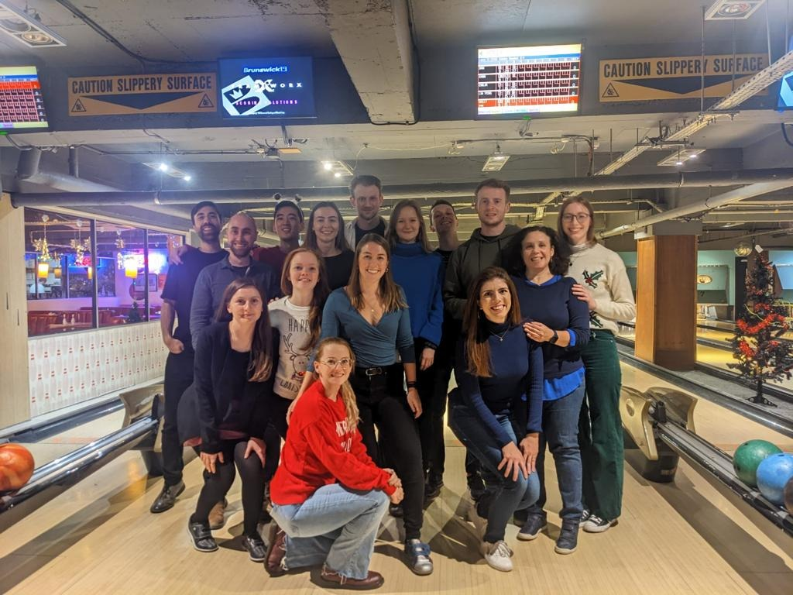



Thanks for listening!

